Slide 1
Election Security
Ronald L. Rivest
MIT
2023-10-12 MIT (Media Lab) Workshop on Misinformation

Slide 2
Outline
Concern: misinformation re election outcome
Security Requirements
Evidence-based Elections
Software Independence
Auditing of Paper Ballots
Remote (Internet) Voting ???

Slide 3
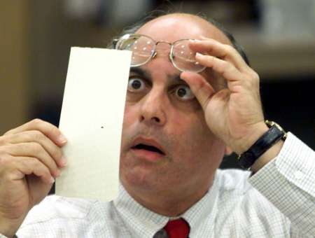
Have we made progress since 2000?
Hanging chads (2000)
Voting Machines at Risk (2015)

Slide 4
How do we vote?

Slide 5
Paper Ballots, mostly

Slide 6
1893 – “Australian” Paper Ballot

Slide 7
Now about 70% HMPB, 25% BMD, 5% DRE HMPB = “hand-marked paper ballot”, BMD = “ballot marking device”, DRE = “direct recording by electionics”

Slide 8
Optical scanners are used for efficient tabulation

Slide 9
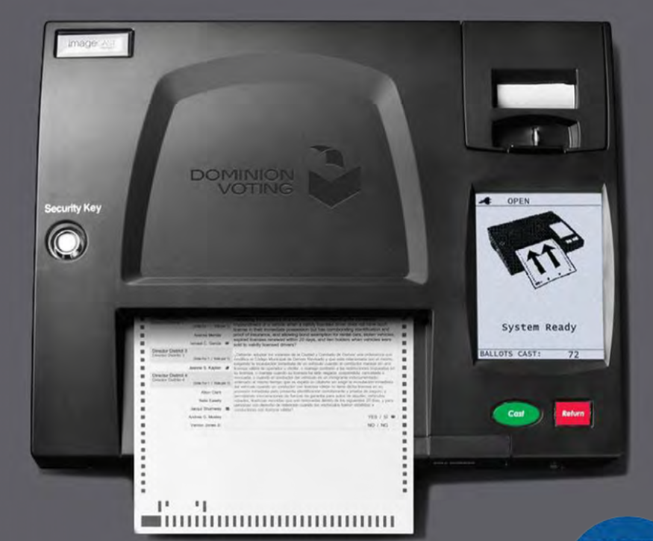

Slide 10
(Concern:) Scanners may introduce systematic errors

Slide 11
Causes of scanner errors
Differences in interpretation between machine interpretation, and hand interpretation based on “voter intent” rules.
Stray marks (e.g. caused by folds)
Configuration errors
Programming errors
Hacking (adversarial attack)

Slide 12
How should we vote?

Slide 13
Security Requirements

Slide 14
Security Requirements
Only eligible voters may vote, and each eligible voter votes at most once.
Each cast vote is secret, even if voter wishes otherwise! -- No vote-selling! -- No receipt showing how you voted!
Final outcome is verifiably correct (auditable) (Prevents misinformation re outcome)
No ``trusted parties’’ – all are suspect! Vendors, voters, election officials, candidates, spouses, other nation-states, …

Slide 15
Evidence-Based Elections
An election system should not only
accurately figure out who won,
but should also
provide convincing evidence
that the winner really won.
(Stark & Wagner 2012)

Slide 16
Software Independence
(Rivest & Wack, 2006)

Slide 17
And Who Do You Hope You Voted For?

Slide 18
Software Independence
Software is not to be trusted!
A voting system is software independent if an undetected error in the software can not cause an undetectable change in the election outcome.
Strongly software-independent if it is possible to correct any such outcome error
Example: Paper ballots (with hand recount)

Slide 19
NASEM Report (9/6/18)
National Academies issued report on ”Securing the Vote”
www.nap.edu/futureofvoting
(159 pages; free pdf)
41 recommendations

Slide 20
Recommendation 4.12 Use voter verifiable paper ballots everywhere by 2020

Slide 21
Recommendations 5.7—5.9 Audit election outcomes!

Slide 22
Recommendations 5.7—5.9 Audit election outcomes!
A risk-limiting audit (RLA) uses manual interpretation of randomly chosen cast paper ballots to verify with high probability the reported election outcome (or correct it, if wrong).

Slide 23
Election Process (paper ballots)
Print ballots; setup
Mark Choices; Verify Vote; Cast Vote!
Optical scanners give initial (“reported”) outcome
Statistical audit of cast paper ballots by hand to confirm/disprove reported outcome
“Brush your teeth; eat your spinach; audit your elections!” -- Poorvi Vora

Slide 24
Auditing of Paper Ballots

Slide 25
Who is audit for?
Losing candidates – to convince them that “they lost fair and square”
The winner – to provide a mandate
The public – to assuage doubts about “rigged elections”
Election officials – to help them provide accurate and efficiently-verified results

Slide 26
What a RLA does not do
A RLA does not address:
correctness of the tally (as opposed to the outcome)
voter eligibility
voter authentication
usability
privacy
chain of custody of paper ballots

Slide 27
Risk-Limiting Audit
RLA Question: What is current ``risk’’? (Probability that if reported winner is incorrect, audit would nonetheless accept it if audit stopped now.)

Slide 28
Recommendation 5.11 No Internet voting! Misinformation (myth): Internet voting can be secure

Slide 29
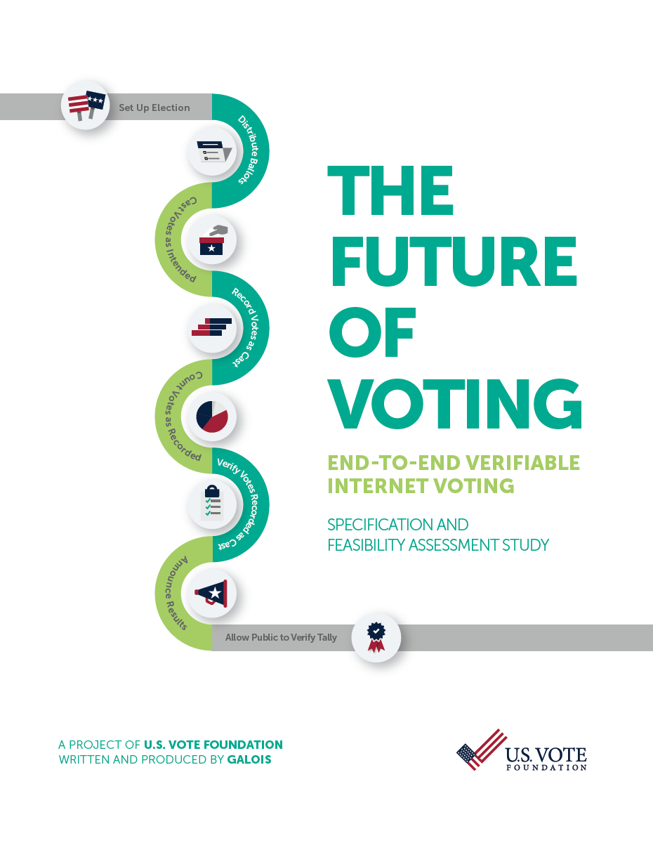
U.S. Vote Foundation 2015 Report on Internet Voting:
Internet voting requires solutions to many as-yet-unsolved problems:
Malware
DDOS attacks
Authentication
MITM attacks
Zero-day attacks on servers
Coercion & vote-selling
…

Slide 30
Conclusions
We can make elections much more secure with post-election risk-limiting audits.
We’re not yet ready for ``internet voting,’’ and may not be for 20 years…
Misinformation re election outcome can be fought with hand-marked paper ballots, documented security for those paper ballots, and risk-limiting audits.

Slide 31
The End
Thanks for your attention!
(and thanks to NSF CSOI and to Verified Voting!)

