Slide 1
Perspectives on Digital Contact Tracing
Ronald L. Rivest
MIT Institute Professor
Algorithm Design, Law, and Policy Workshop
Simons Institute, Berkeley
July 20, 2020

Slide 2
Outline
(Disambiguation Page)
Manual Contact Tracing
Digital Contact Tracing
Ranging Accuracy – TC4TL (Too Close For Too Long)
Privacy
Integration with PH
Adoption
Effectiveness
Law
Policy
Conclusions

Slide 3
(Disambiguation Page)
PACT (aka “PACT-East”) * “Private Automated Contact Tracing” http://pact.mit.edu/
PACT (aka “PACT-West”) “Privacy Sensitive Protocols and Mechanisms for Mobile Contact Tracing” https://arxiv.org/abs/2004.03544

Slide 4
Manual Contact Tracing (MCT)
When a person (“index case”) tests positive, finding all or most of the people he may have exposed (“contacts”) is called contact tracing.
Manual CT is based on interviews with the index case, and phone calls to contacts.
CT allows contacts to be quarantined, symptom-checked, and tested.
CT is a powerful method for “flattening the curve”, as it removes infectious people from circulation.
Classic method, used widely for many pandemics.
Limitations: speed, compliance, and recall ability.

Slide 5
Digital Contact Tracing
PACT protocol inspired by Apple “Find My” (taught by Yael Kalai and me in Spring 2020 security course)
Uses Bluetooth by Apple devices to sense proximity.
Phone broadcasts values; these change frequently for privacy protection.
Public DB allows owner to find “where lost phone was last seen” while protecting privacy.
PACT protocol is similar: phone broadcast changing “chirps”.
If owner tests positive, can upload to DB the seeds for generating chirps.
Others can check parties in a decentralized manner if they have heard chirps of infected.
Similar protocols developed concurrently: DP3T, TCN, …
Dozens of countries now rolling out such apps…

Slide 6
PACT (East) team
PACT organized early March
Leadership:
MIT campus: me, Danny Weitzner
MIT Lincoln Lab: Marc Zissman, Israel Soibelman
MGH: Louise Ivers (Medical / Public-Health advisor)
Many organizations represented: MIT, MIT Lincoln Lab, MGH, Weizmann, BU, Brown, IBM, CMU, MITRE, Northeastern, Qualcomm, Sandia, …
> 100 people (particularly strong on “layer 1” = BT ranging)
Strong relationships with other teams, Apple|Google, other vendors, jurisdictions, public health, …
PACT role: technology evaluator and advisor, not app developer; more interest in “helping good things happen” than “taking credit”

Slide 7
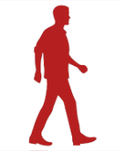
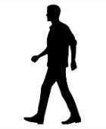
TC4TL Accuracy (Distance & Time)
CDC says “too close for too long” should be < 6 feet for > 15 minutes.
BT is for local communications (<30m) -- can it be used for ranging?
Received signal strength (RSSI) depends on:
Transmitter power
Phone orientation (carriage)
In-pocket / out-of-pocket
Indoors / Outdoors (multipath)
Intervening bags of water (bodies!) – but not intervening walls!
This may be the biggest challenge for BT-based contact tracing.
Chirp Log
Chirp Log
Approx 6 feet
Bluetooth
Chirp
Index Case
Contact Distance
Contact

Slide 8
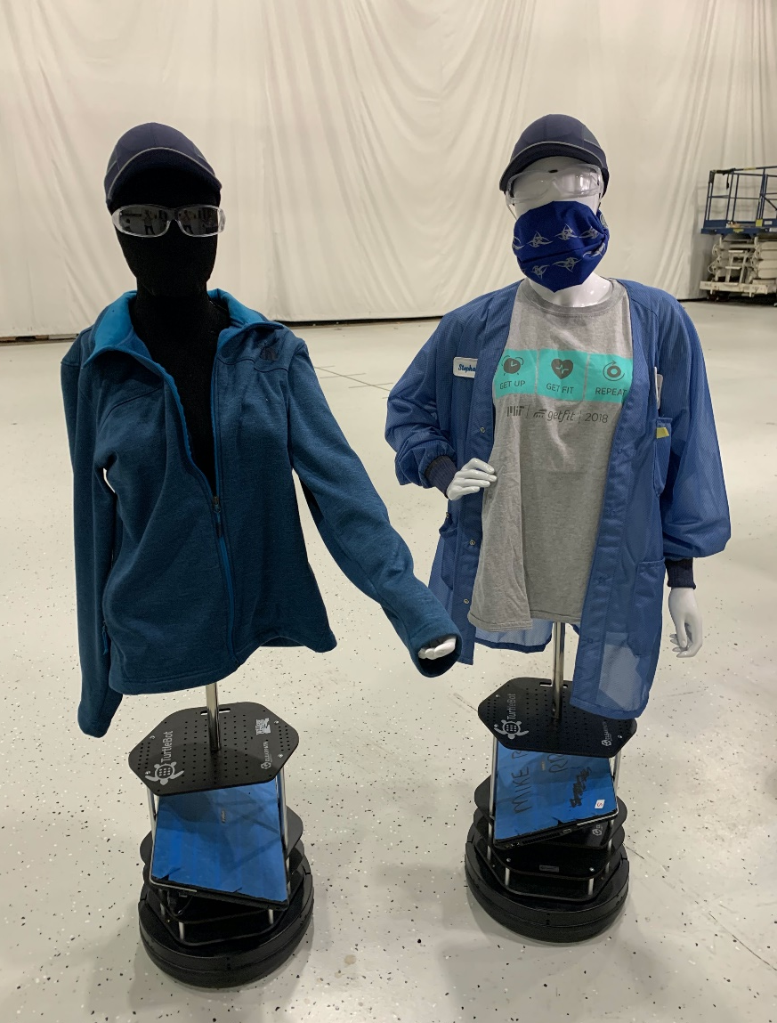
TC4TL (Cont.)
Getting sufficient samples can also be dicey (battery drain!)
MIT LL has put incredible effort into BT phenomenology
Paper by Gary Hatke et al. on arXiv gives details https://arxiv.org/abs/2006.15711 (June 30, 2020)
Data Collection Coalition – collects BT ranging data
NIST challenge applying ML to TC4TL: https://www.nist.gov/itl/iad/mig/nist-tc4tl-challenge
PACT also exploring fixed beacons, wearables, ultrasound, UWB

Slide 9
Privacy
No data leaves phone without user consent.
No usage of GPS location.
Phone broadcasts changing pseudorandom “chirps”, so no tracking.
Phone records “chirps it has heard”
Infected users (who test positive) may post seeds for their chirps.
Phone matches (locally!) against posted DB of “infected chirp seeds”
No need for central DB to store sensitive personal information
Match causes user to be alerted (stay-at-home, watch symptoms, test!)
Extensions exist for dealing with replay & relay attacks.

Slide 10
Integration with Public Health
Goal is to improve and extend manual contact tracing, not to replace it.
Contacts need information about what to do, where to obtain support services, etc.
Digital contact tracing should feed into MCT software.
Digital contact tracing can make MCT faster and more complete.

Slide 11
Adoption can be a challenge
For DCT to be effective, both parties need to be running DCT service.
So 50% adoption rate may mean only 25% of contacts get logged.
Apple and Google have announced AEN (Automatic Exposure Notification) an API in iPhones and Androids, providing interoperability. (A huge, and very welcome, development! Thanks, A|G!!)
People may resist adoption because:
Fear of “big brother” (privacy concerns; police; ICE; housing)
Confusing UI (e.g. request on Android for “location services” permission)
Rollouts in EU (Switzerland, Germany, Denmark) have >10% so far.

Slide 12
Effectiveness
Can digital contact tracing really help? Can it save lives?
Ferretti et al. (Science, May 8 2020) show via model:
“Immediate notification through a contact-tracing mobile phone app could, however, be sufficient to stop the epidemic if used by a sufficiently high proportion of the population.”
Singapore: digital contact tracing does reveal new contacts, beyond those found by manual contact tracing.
DCT may allow for faster alerts of duplicate contacts.
But: mask-wearing may decrease number of strangers you infect, and thus decrease utility of DCT…

Slide 13
Venn Diagram
Numbers are made-up (100 total).
New contact (1 in pink) discovered by DCT.
Duplicate contacts (17 in green) can get faster notification.
5
MCT
Infected
1
1
2
1
15
15
Other: 60
DCT

Slide 14
Law
Most interesting legal questions (?):
Can law enforcement access or use contact-tracing information in any way?
Do we need to update laws concerning protection and sharing of medical data, for handling DCT data?

Slide 15
Policy
Can/should app use be made mandatory? (e.g. for jurisdictions, services, businesses, schools??)
Tension between Public Health and Privacy: more information revealed to system may improve public health results, at a cost to privacy:
GPS data
“who infected me?”
Who decides policy: government or high-tech?
How/whether to turn off DCT when this pandemic is over?

Slide 16
Conclusions
We have come a long ways since COVID-19 appeared, including:
Decentralized privacy-preserving protocols
Much better understanding of BT phenomenology
Apple-Google collaboration on AEN API
Yet there remain significant challenges:
Improving ranging accuracy
Dealing with fragmented nature of US health care
Achieving sufficient adoption rates

